Slide 1
Suicides Among Veterans in the United States
Flying Dynamos:
Chris Prabhu Neelayadhatchi (Neela) Sridharan
Saranya Babuselvan Alaind (Alli) Sklar

Slide 2
Background
Mental health disorders such as PTSD and Depression largely effects the military community. When left untreated, this raises the risk of suicide.
The lack of
access to health clinics
knowledge and awareness of symptoms and how to seek professional help
belief that treatment is possible, and
social support
are the leading factors to the high suicide rates among veterans who experience PTSD and depression.

Slide 3
Questions and Motivation
Questions:
What is the rate of veteran suicides and how does that compare to non-veterans?
Which states have the most veterans’ death due to suicide and what is the total availability of Veteran Affairs (VA) medical centers in those high risk states?
Which veteran age group(s) have the highest rate of suicide?
Do male veterans have a higher rate of suicide than female veterans or vice versa?
Is there a trend occurring with suicide related deaths among veterans and if there is one, is it increasing or decreasing?
Motivations:
The analysis of this information will help the VA Office of Mental Health and Suicide Prevention gain insight into high-risk populations and share that information with community-based health care providers and partners, continuing to expand the network of support for veterans.

Slide 4
Identifying Sources & Retrieving the Data
Data sources:
Kaggle(from a contributor who had retrieved the datasets from a news broadcasting company)
Veteran Affairs report
Data.gov
From these data sources, we retrieved CSV files in order for us to analyze the data.

Slide 5
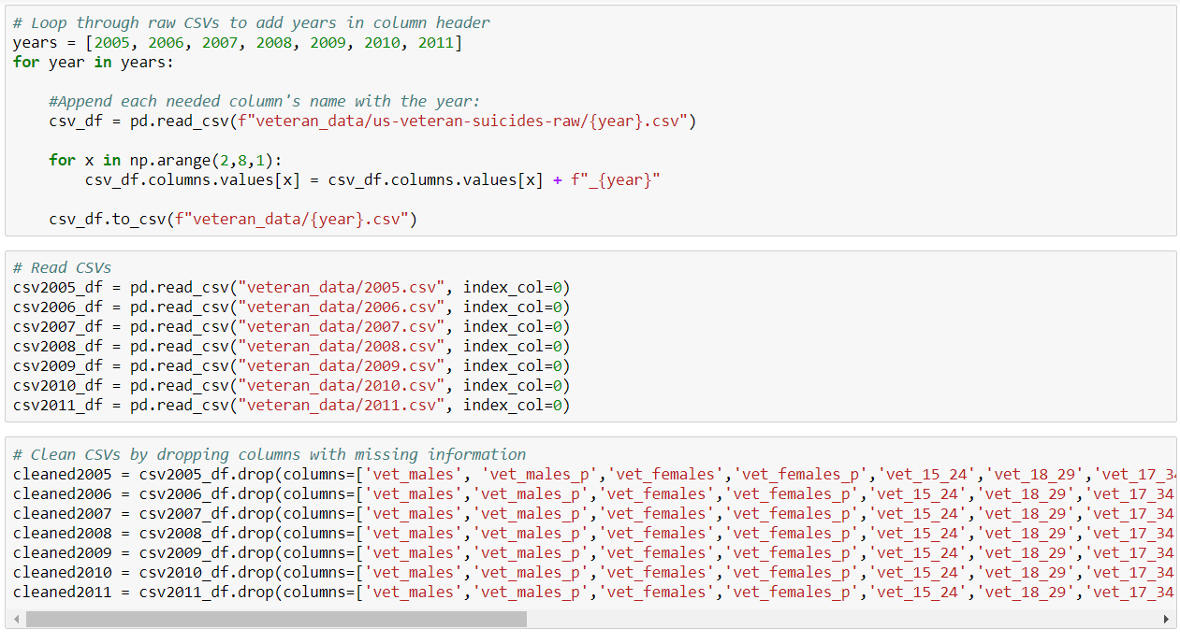
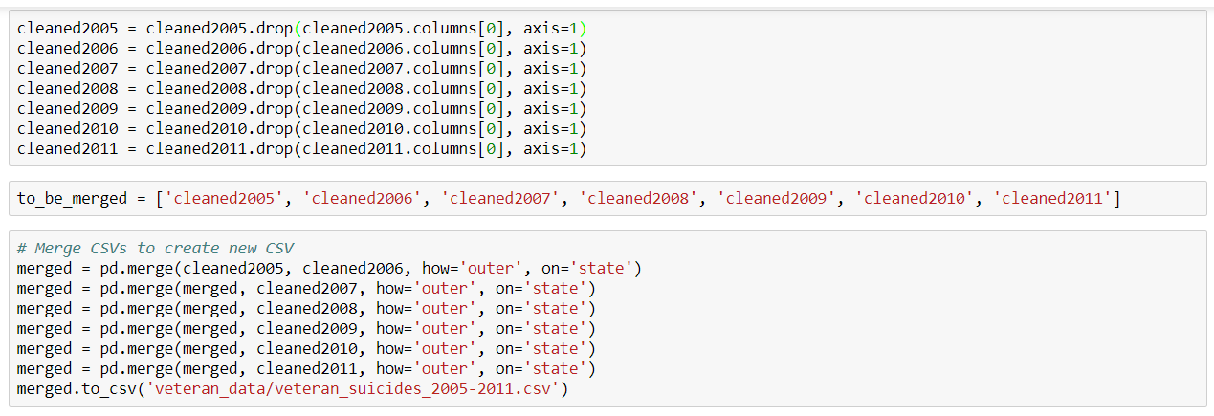
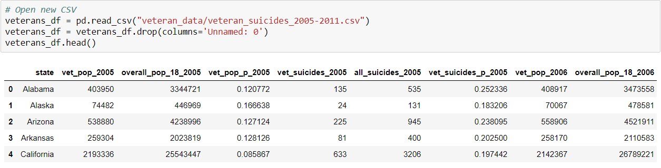
Assembling and Cleaning The Data
We used pandas and csv dependencies in order to clean the data.
We dropped columns that had missing information.
Merged all the CSVs by the state column and created an new CSV

Slide 6
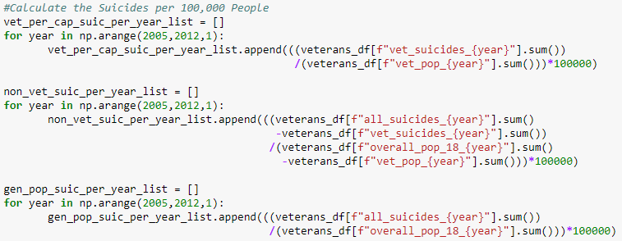
The Analysis Process: Veterans vs. Non-Veterans Suicides
Calculated the average suicide rates per 100,000 people for both veterans and non-veterans.

Slide 7
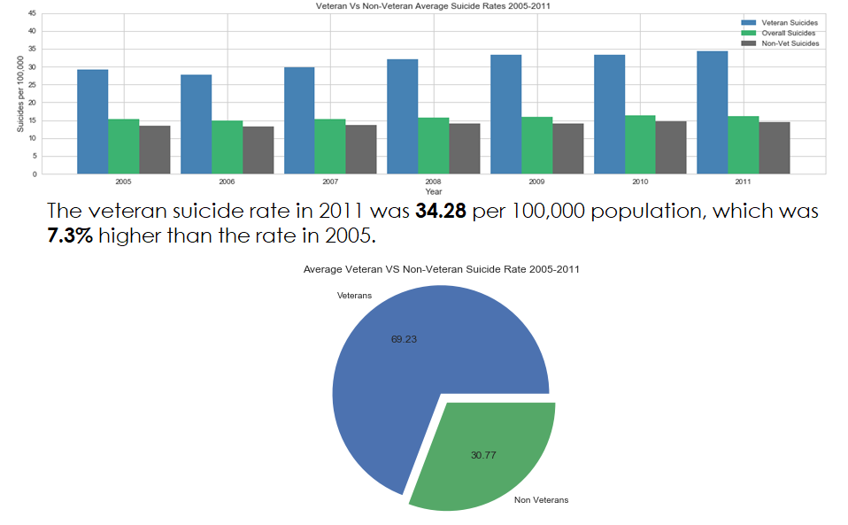
Findings #1 : Veteran vs. Non-Veteran Suicides
The average annual percent increase in veteran suicide rate was about 1.22% per year from 2005 to 2011.

Slide 8
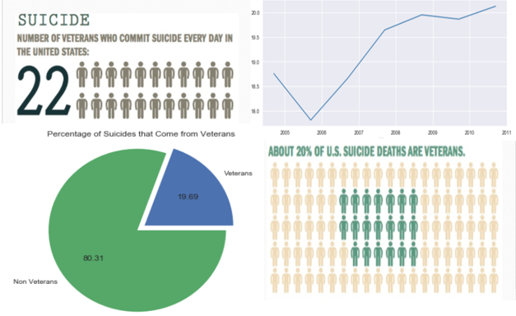
Findings #1: continued
On average, there are 22 veteran suicides related death per day.

Slide 9
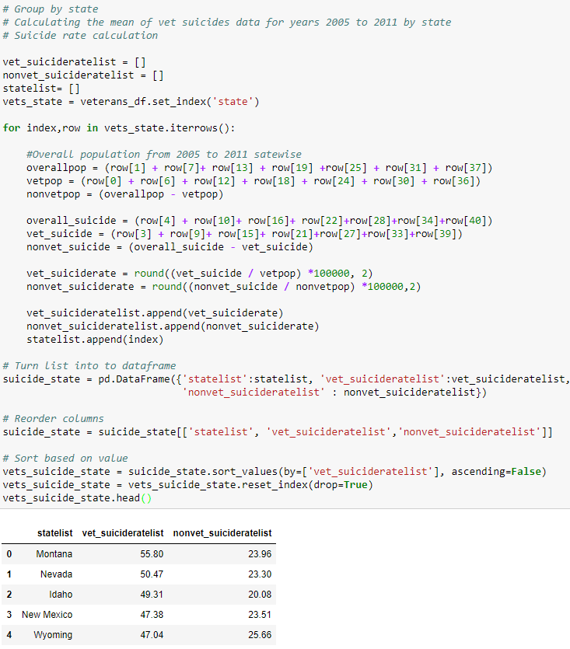
The Analysis Process: Veteran Suicides By States & VHA Centers
Calculated the veteran suicide rates per 100,000 people by using iterrows loop and creating a new data frame showing rates of veteran suicide by state.

Slide 10
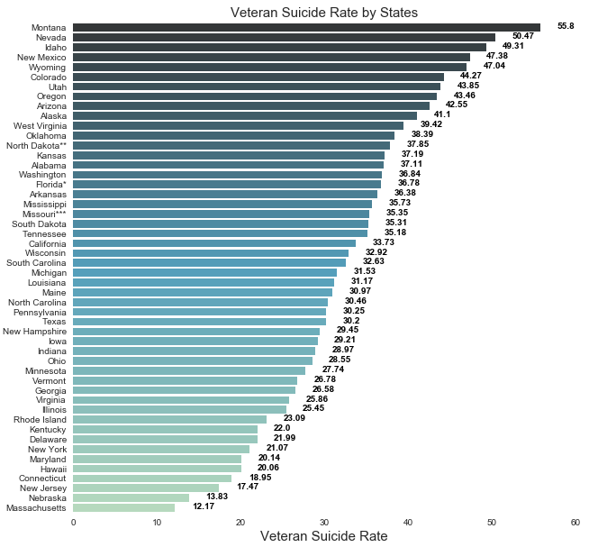

Findings #2: Veteran Suicide by State
The four states with the highest suicide rates are Montana, Idaho, Nevada, and New Mexico. The suicide rates in these four states stands at 50.74 per 100,000 individuals or higher, which is far above the overall veteran suicide rate of 34.28 and the rest of the country at 31.02.
Montana, Idaho, Nevada, and New Mexico had the highest rates of veteran suicide as of 2011.

Slide 11
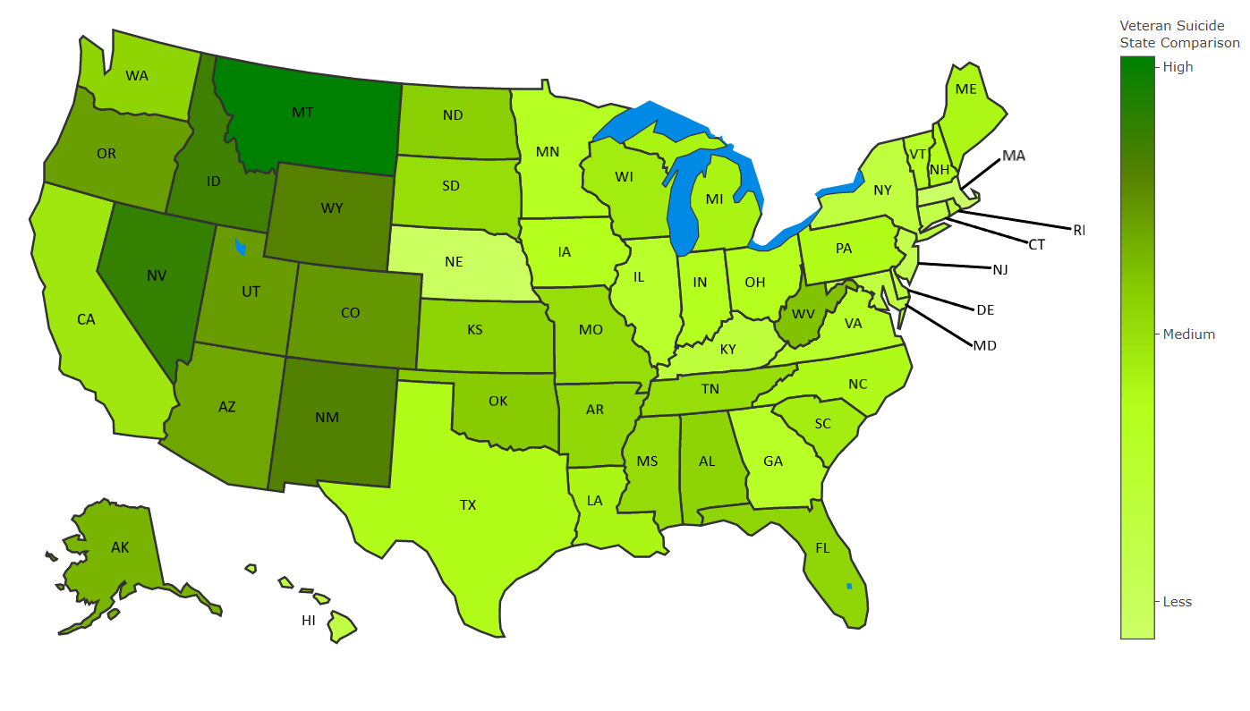
Findings #2: continued
The average rate of veteran suicides in the West (excluding California & Washington) 47.16. The reset of the country had an average rate of 29.14.
Highest suicide rates in the West:
Montana: 55.8
Nevada: 50.47
Idaho: 49.31
New Mexico: 47.38
Wyoming: 47.04
Colorado: 44.27
Utah: 43.85
Oregon: 43.46
Arizona: 42.55

Slide 12
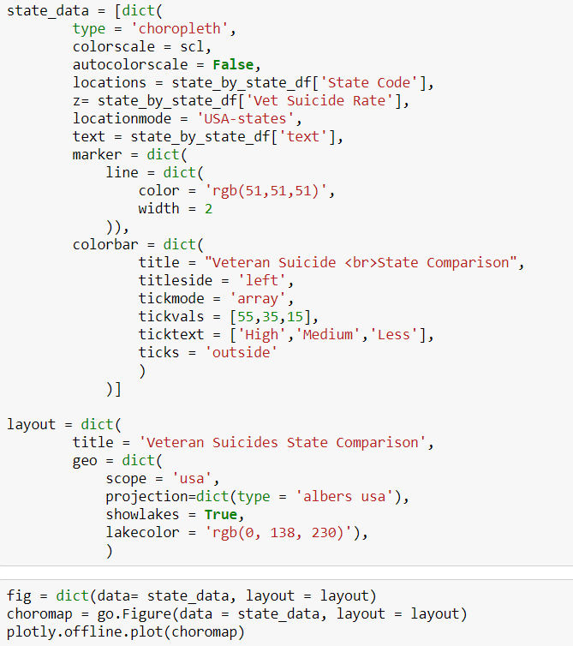
Code for U.S. Geo Map of Veteran Suicide Rates
The dependency called plotly was used to create our U.S. map depicting the rate of veteran suicides by state (light green shows the lowest rate of suicide and dark green shows the highest rate of suicide).

Slide 13
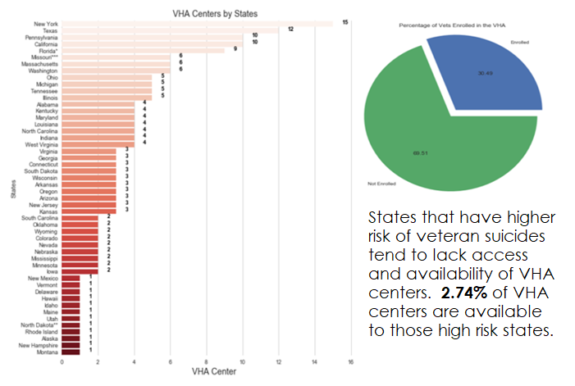
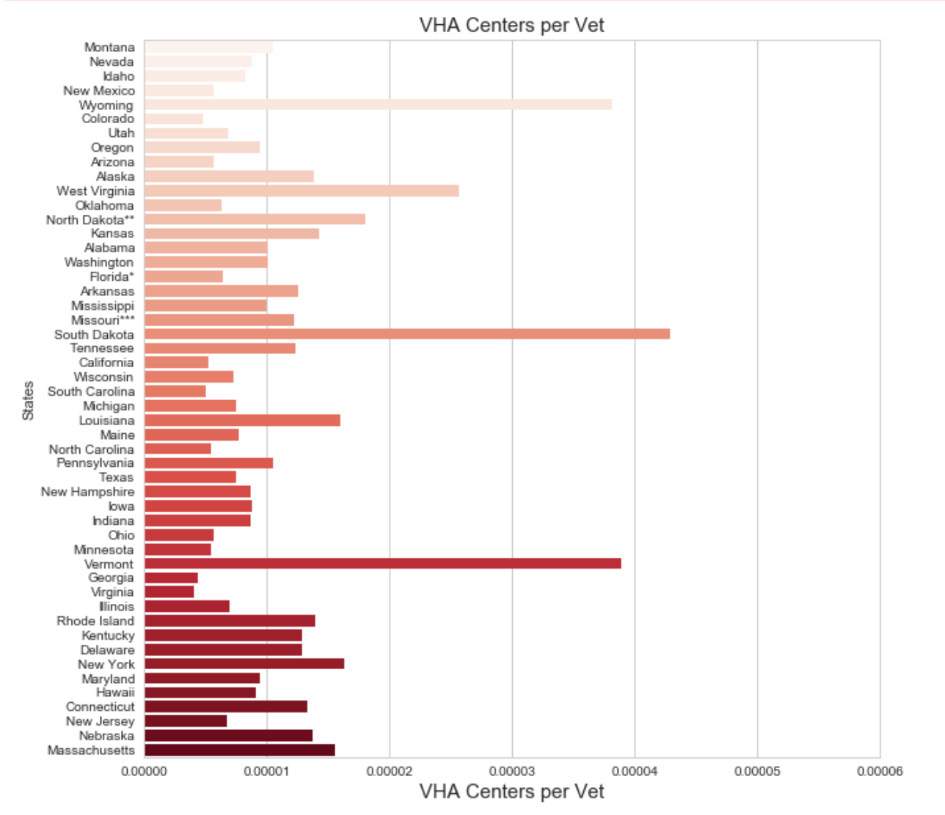
Findings #2: continued

Slide 14
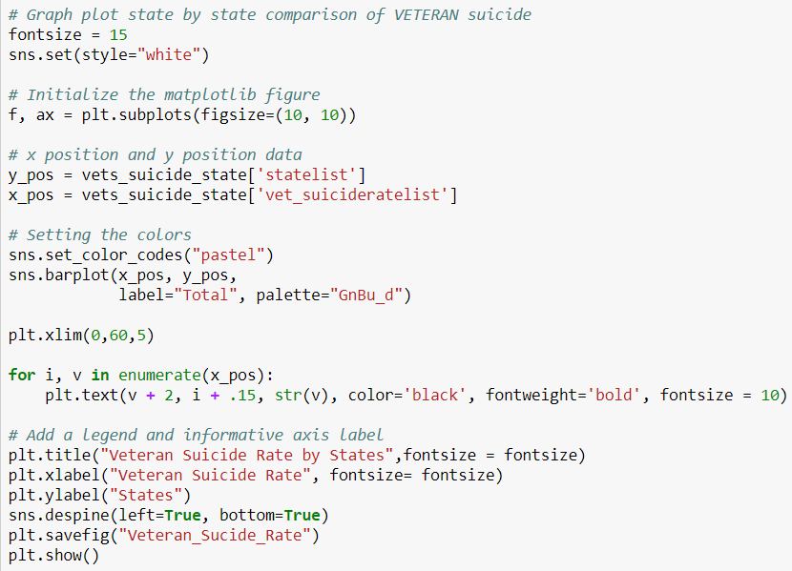
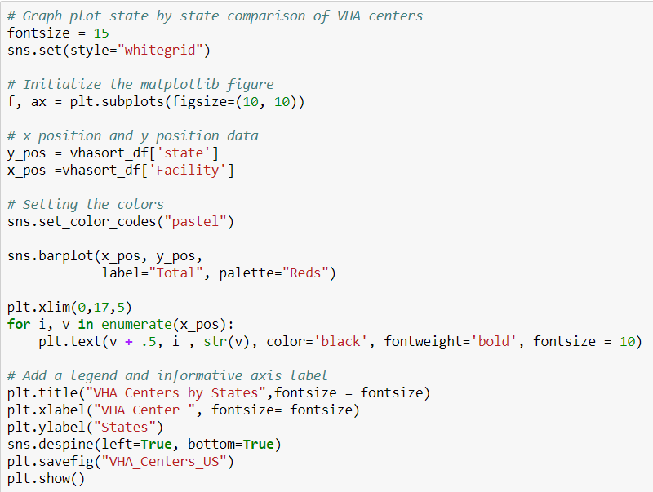
Codes for State by State Bar Charts
Code for veteran suicide rate by state
(used seaborn dependencies)
Code for VHA centers by state
(used seaborn dependencies)

Slide 15
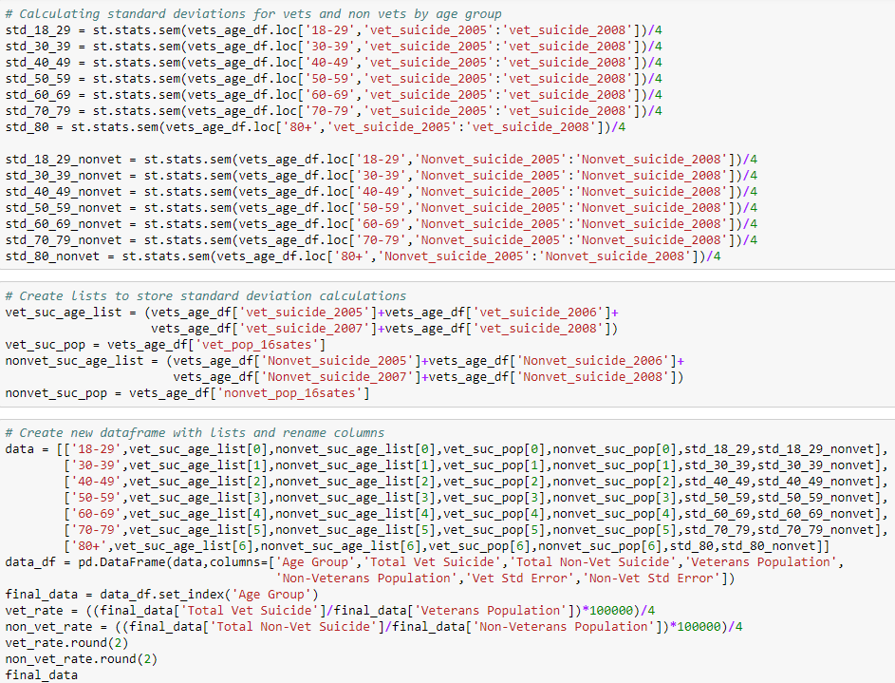
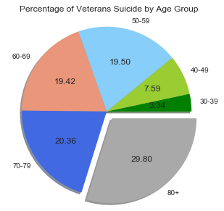
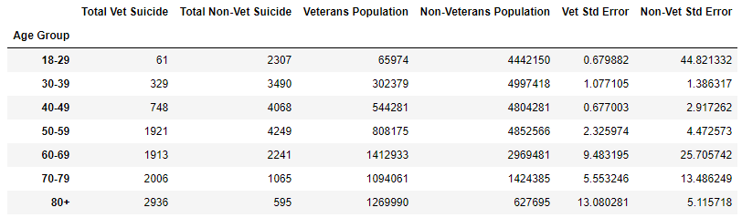
The Analysis Process: Veteran Suicides by Age Group
Calculated the means and standard deviations and created data frame categorized by age group.

Slide 16
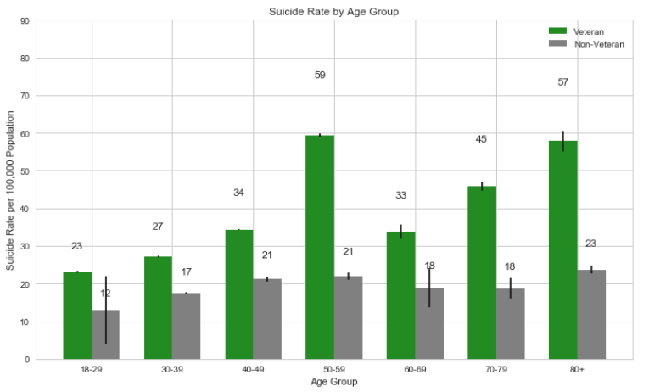
Findings #3: Veteran Suicide by Age Group
The risk of suicide is 19% higher among veterans compared to civilians.

Slide 17
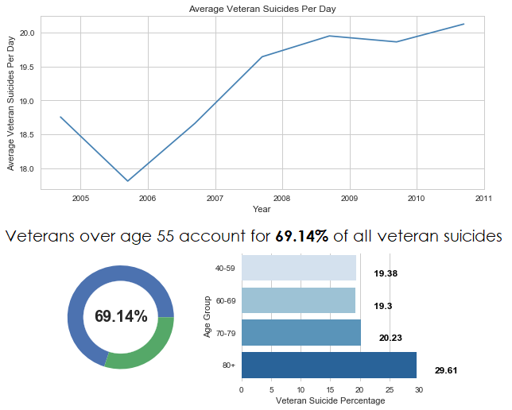
Findings #3: continued
After war, a lifetime of struggle—
Estimated amount of veteran suicides were 22 per day (as of 2011).
From 2005 to 2011, older veterans make up for the majority of military suicides—roughly 69% were age 55 or older.

Slide 18
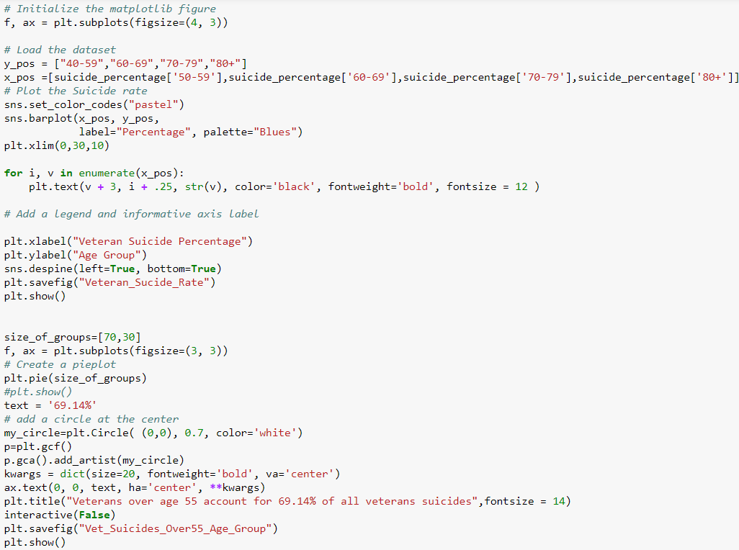
Code for Veteran Suicide Rates by Age Group Bar and Donut Chart
Matplotlib’s feature called interactive and seaborn were used to make the bar and donut chart.

Slide 19
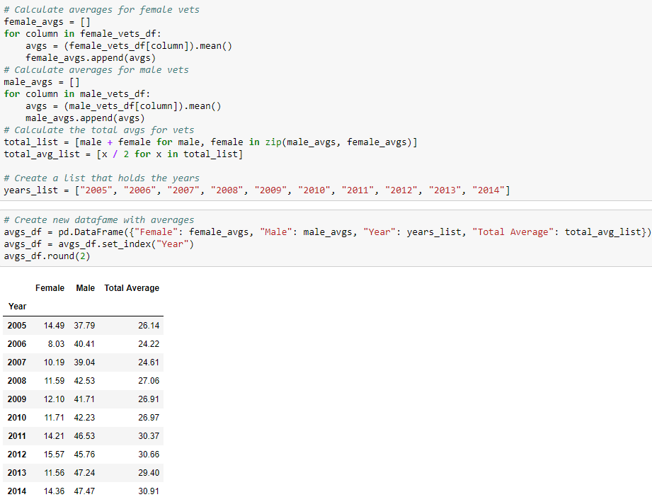
The Analysis Process: Veteran Suicides by Gender
Calculated the mean of male, female, and total rate of suicides and created a new data frame categorized by year.

Slide 20
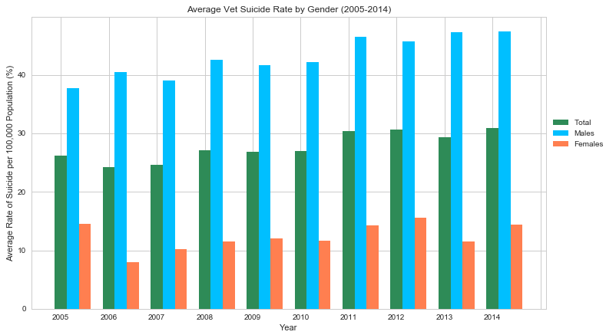
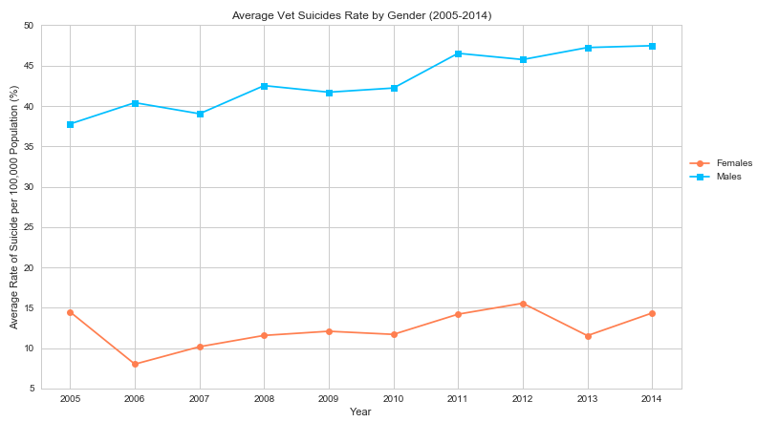
Finding #4: Veteran Suicides by Gender
There is a noticeably higher rate of suicide among male veterans than female veterans. There was an increase of in suicide rates of male veterans by 9.69% (from 2005 to 2011) with an overall average rate of 43.07%. Whereas, female veterans suicide rates have been fairly consistent throughout the ten years with an overall average of 12.38%.

Slide 21
Limitations
Unable to get authorized data directly from the VA department
Analyzed data is from 2005 to 2011 based on web search (Kaggle)
Suicide rate data by gender was limited only from 2005 to 2014
Data.gov had limited data sets from 2005 to 2008

Slide 22
Conclusion
It is very apparent that veteran suicides are on the raise (as shown in our analysis). Here are our suggestions to help combat the increase in suicide rates among veterans:
To improve the health and well-being of our veterans who have served this nation, requires a collaboration between public and non-profit mental health providers at the state and local levels.
VA need expand health manpower resources by encouraging collaboration arrangements with nonprofit organizations to work with the VA in their communities to expand the availability of health professionals to address the problem of suicide among veterans.
Need to inform and encourage elderly veterans to seek mental health assistance. A great way to start is by creating support groups.
Opening smaller low cost/free clinics in rural parts of those states that have high suicide rates in order to create accessibility for veterans to seek professional help.
VA needs to do a better job of developing strategies for routine mental health screening and early intervention for all service members before they return to civilian life.

